Slide 1

Manufacturing Defect Reduction Initiative
Curtis Flowers
DAT 475
Notes:
Good morning, everyone.
Today, I will present our Manufacturing Defect Reduction Initiative. This initiative focuses on using data to identify and reduce quality issues in our production process. Using insights from Power BI, I can identify where defects occur, what causes them, and how to improve efficiency across shifts and product lines. The goal is to move away from assumptions and use operational data to find root causes, validate patterns through hypothesis testing, and propose evidence-based solutions for continuous improvement. By the end of this presentation, you will understand how this analysis leads to faster decision-making for improving manufacturing quality.

Slide 2

Defining the Manufacturing Challenge
Problem: Rising defect rates across models and shifts are affecting quality and efficiency.
Data Source: The 2025 production cycle dataset includes model ID, defect type, shift, and inspection week.
Desired Outcome: Reduce total defects by 20% and improve process consistency across all shifts.
Method: Use Pareto analysis, fishbone diagrams, ANOVA testing, and Power BI for identifying and monitoring root causes.
Notes:
This project will focus on addressing the rate of manufacturing defects that are increasing and having a negative impact on both productivity and product quality. The analysis includes data collected during the 2025 production cycle, including defect counts, types, and performance across different shifts.
The goal here is to use structured analytics and hypothesis testing to identify the main sources of defects, and recommend actionable improvements to processes. By focusing on the most significant defect types and standardizing performance across all shifts, the team hopes to achieve a minimum of 20% reduction in defects, alongside a measurable enhancement in overall process reliability.

Slide 3

Data Preparation & Methodology
Data Preparation Steps:
Extracted production data from the 2025 case study file.
Removed duplicate and incomplete records.
Created a new field called “Week Number” from Inspection Week data for trend analysis.
Converted the Shift and Model categories into numbers for statistical tests.
Analytical Methods:
Pareto Chart: Found the top 20% of causes responsible for 80% of defects.
Fishbone Diagram: Identified potential root causes by category.
ANOVA Test: Checked the differences in defect counts across models.
Power BI Dashboard: Showed trends and performance metrics visually.
Notes:
To ensure accuracy, we cleaned the dataset thoroughly. We removed missing or duplicate records and added a ‘Week Number’ field for time-series analysis in Power BI. The data was organized to provide insights, such as defect type and shift time, and to perform numeric testing using ANOVA.
By combining descriptive and inferential analysis, we gained clarity and validation. Pareto analysis showed where to focus our improvement efforts, while ANOVA tested whether variations existed among models.

Slide 4
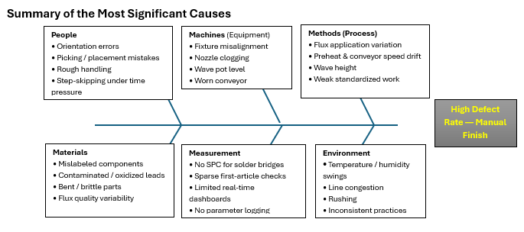
Root Cause Analysis (Fishbone Diagram)
Notes:
The fishbone diagram shows potential causes grouped into six main areas: People, Machines, Methods, Materials, Measurement, and Environment.
The diagram identifies common issues like rough handling, misalignment of fixtures, process variations, and inconsistent environmental conditions.
These groups helped decide the next step: checking which factors are most closely linked to the defects observed.

Slide 5
ANOVA Results and Interpretation
Results:
F = 0.5789
p = 0.5646 (p > 0.05 → fail to reject H₀)
Conclusion: No statistically significant difference between models. Defects are process-related rather than model-specific. Improvement efforts should target production consistency and system-wide process control.
Hypothesis Testing (One-Way ANOVA)
H₀: No significant difference in mean defect rates across models.
H₁: At least one model differs significantly.
Notes:
We used a one-way ANOVA to see if defect rates differ among production models. The F-statistic was 0.5789, and the p-value was 0.5646, which is higher than the 0.05 threshold. Therefore, we do not reject the null hypothesis.
This means that defects are not limited to just one model. Instead, they are likely caused by larger issues in the process, like workflow differences, varying levels of training, or equipment misalignment.
The results suggest we should focus on improving processes across all models. This could include standardizing procedures and providing more training for operators, rather than focusing on specific product lines.

Slide 6
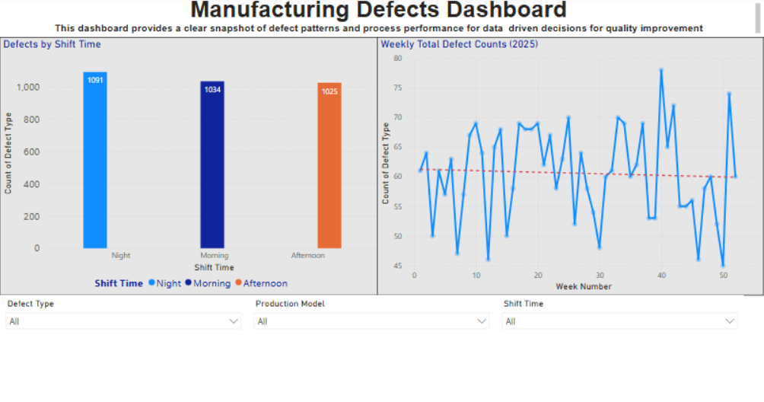
Power BI Dashboard Overview
Weekly Total Defects — shows weekly fluctuations and gradual improvement.
Defects by Shift Time — shows highest defect count on night shift.
Slicers: Filter by Production Model, Shift Time, and Defect Type for targeted insights.
Notes:
This Power BI dashboard shows the results of our analysis in a clear, interactive view. The bar chart on the left displays the number of defects by shift, highlighting that the night shift has the most defects. The line chart on the right illustrates weekly defect trends throughout 2025, showing an overall pattern of gradual improvement, even with some ups and downs. Slicers at the top allow users to focus on specific models, shifts, or types of defects. This helps managers and quality teams find out exactly where they need to take corrective action.

Slide 7
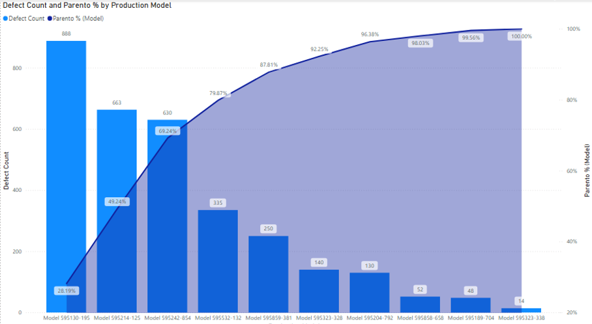
Pareto Analysis (Defect Count by Production Model)
This chart shows the total number of defects for all production models
The three models at the top account for approximately 80% of all documented defects
Focusing on these high-impact models presents the greatest opportunity for reducing overall defects.
Notes:
The Pareto chart shows that a few production models cause most of the defects—about 80 percent come from just three models.
This supports the 80/20 rule, which means focusing on a few key models can lead to the biggest improvements.
These findings helped me focus my investigation on specific production lines for a closer analysis.

Slide 8
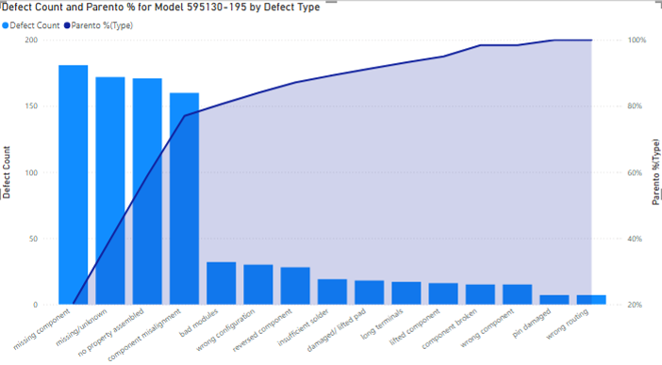
Pareto Chart – Defect Count by Type (Model 595130-195)
This chart shows which defect types contribute most to the defect count for Model 595130-195
Missing components, misalignment, & improper assembly represent the majority of total defects
The Pareto curve confirms that roughly 80% of total defects come from a small number of defect categories
Notes:
This Pareto chart shows the main defect categories for Model 595130-195.
The top three issues are missing components, component misalignment, and improper assembly.
According to the Pareto principle, fixing these major problems will have the biggest impact on reducing total defects.
These findings led us to review the assembly procedures, check the components more carefully, and improve operator training for this model.

Slide 9
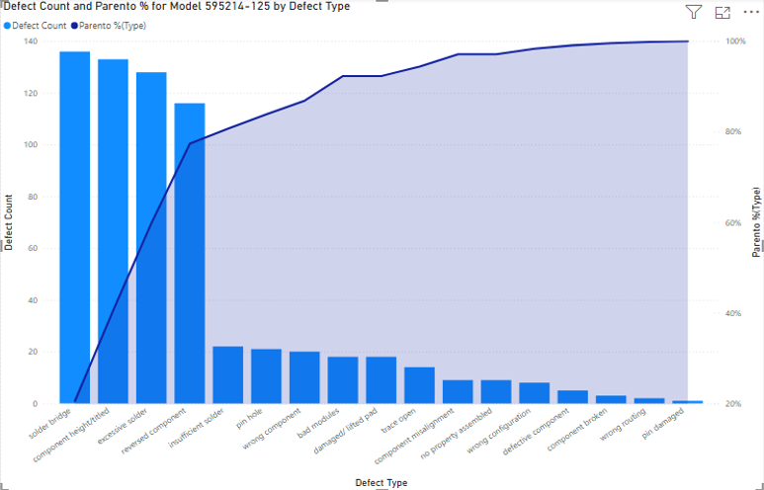
Pareto Chart – Defect Count by Type (Model 595214-125)
Majority of defects come from a few key types: solder bridges, tilted components, and pin holes.
The Pareto curve confirms that the top 20% of defect categories cause nearly 80% of total defects.
Addressing these top causes offers the highest potential for immediate quality improvement.
Notes:
“This Pareto chart focuses on Model 595214-125, showing the frequency of each defect type.
The results highlight that a handful of defect types account for most of the production issues. — Solder Bridges, Tilted Components, and Pin Holes
The cumulative Pareto curve shows that roughly 80% of total defects come from these causes.
This insight guided the team to prioritize process checks, soldering calibration, and component handling improvements for this model.
By targeting these categories, we can achieve the greatest reduction in total defect counts with minimal resource investment.”

Slide 10
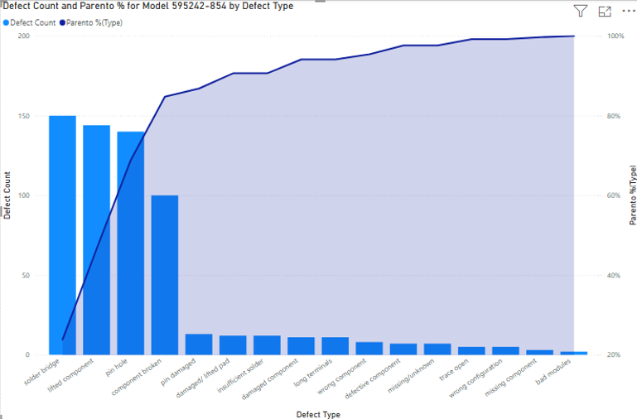
Pareto Chart – Defect Count by Type (Model 595242-854)
Model 595214-854 has three common defects in its production are solder bridges, tilted components, and pin damage.
The Pareto curve shows that these defects cause nearly 80% of all problems.
By fixing these issues, production quality will be improved.
Notes:
“This Pareto chart focuses on Model 595242-854 and highlights how a few key defect types continue to drive the majority of production issues.
The most common problems—solder bridges, tilted components, and pin damage—represent the largest share of total defects.
The cumulative Pareto curve clearly demonstrates the 80/20 pattern once again, emphasizing that by concentrating improvement efforts on these top contributors, we can achieve the most meaningful reduction in defects.
These insights guided corrective action plans targeting soldering process calibration, component alignment verification, and operator handling procedures for this production model.”

Slide 11
Key Findings:
~80% of total defects come from 3 production models .
Defects are consistent across shifts → systemic process variation.
No model-specific variance (confirmed by ANOVA).
Weekly defect counts show gradual improvement over time.
Next Steps:
Standardize assembly and inspection processes across shifts.
Implement tracking for top 3 defect types.
Reinforce training and an equipment calibration schedule.
Use Power BI dashboard to monitor defect trends monthly.
Notes:
The results of this project shows that only a few models and types of defects cause most quality issues. This demonstrates the Pareto principle, which means that a small number of causes lead to most problems. We observe defects across all shifts, proving that the issue is systematic, not limited to just one shift. The ANOVA test confirms this, showing no significant differences between the models.
Fixing this situation will involve focusing on standardizing processes, improving training, and using the Power BI dashboard for proactive monitoring. The next step is to implement these findings in production, measure short-term improvements, and evaluate defect reduction over the next quarter.

